Slide 1
Display memory
Recommended reading:
Chapter 6. Computer architecture and Assembly language programming by Belal Hashmi.

Slide 2
Printing character ‘A’ on screen
Whenever you write something into video memory (at address 0xB800), it gets displayed on screen.
MOV AX, 0xB800 ; You can’t move immediate value to ES, so using AX for this.
MOV ES, AX; ; Initialize ES with video memory address B800.
MOV DI, 0; ; Screen location top left.
MOV [ES:DI], 0x0741;
In 0x0741, 0x41 is the ASCII value of the character ‘A’ and 0x07 is the attribute byte.
Attribute byte specifies the color of the background and color of the character.

Slide 3
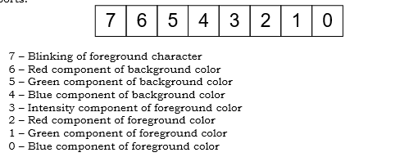
Attribute byte
In the instruction, “MOV [ES:DI], 0x0741”, 0x07 is the attribute byte.
Expanding 0x07 in binary results in 0 0 0 0 0 1 1 1
7 – Blinking of foreground character
6 – Red component of background color
5 – Green component of background color
4 – Blue component of background color
3 – Intensity component of character color
2 – Red component of character color
1 – Green component of character color
0 – Blue component of character color
Character displayed will be white (all colors present R=1,G=1,B=1)
Background will be black (no colors present R=0,G=,,B=0);

Slide 4
Attribute byte
If 0x12 is the attribute byte.
Expanding 0x12 in binary results in 0 0 0 1 0 0 1 0
7 – Blinking of foreground character
6 – Red component of background color
5 – Green component of background color
4 – Blue component of background color
3 – Intensity component of character color
2 – Red component of character color
1 – Green component of character color
0 – Blue component of character color
Green character (2nd bit is 1, G=1);
Blue background (4th bit is 1, B=1);

Slide 5
Displaying Characters (a → Z)
MOV AX, 0xB800
MOV ES, AX
MOV CX, 26
MOV AX, 0x0741;
MOV DI, 0 ; Prints characters starting from top left.
L1:
MOV ES:[DI], AX
INC AX; ; incrementing AX updates ASCII to next character.
ADD DI,2 ; Pointing to next location on screen.
LOOP L1 ; Repeating CX times.
.EXIT

Slide 6
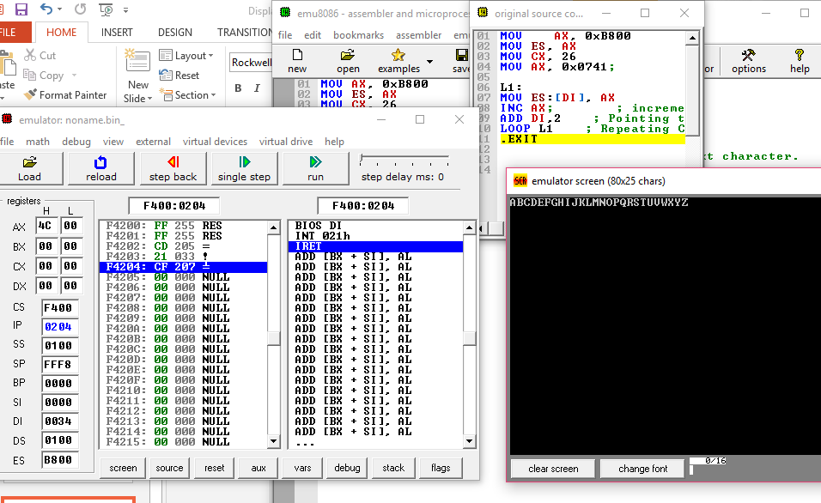

Slide 7
Display numbers (0→ 9)
MOV AX, 0xB800
MOV ES, AX
MOV CX, 10
MOV AX, 0x0730;
MOV DI, 10 ; Prints characters starting from column 5th in first row.
L1:
MOV ES:[DI], AX
INC AX; ; incrementing AX updates ASCII to next character.
ADD DI,2 ; Pointing to next location on screen.
LOOP L1 ; Repeating CX times.
.EXIT

Slide 8
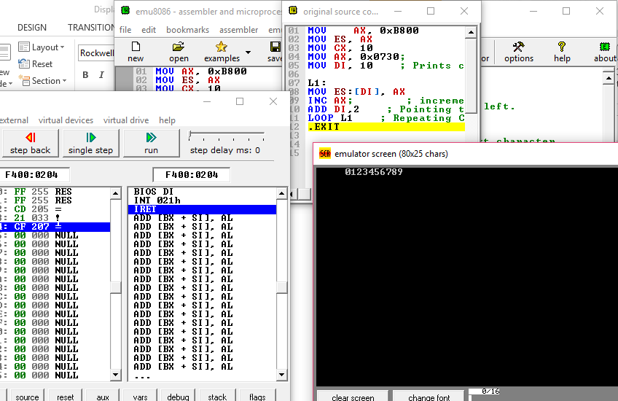

Slide 9
Screen calculation
There are 80 columns and 25 rows on the screen.
To print a character, two bytes are written at that specific location.
So, 160 bytes (80 characters) can be written in one row.
To write a character at top left position, offset di=0 and to display a character at top right position offset di=158.
Total characters that can be printed at a time are 80*25=2000.
Offset di of the character at bottom right will be 3998.
For example, if you write mov es:[di], 0x0741 when di is 3998. Character ‘A’ will be printed at bottom right position.

Slide 10
Exercise questions
Question#1: Write program to display a string on screen?
Question#2: Write subroutine to calculate the length of string. Your subroutine should take the address of string as parameter and should return the size in CX register. Let the string be str db ‘This is Coal Fall-2017’, 0;
Question#3: Write a subroutine that will display the length of string (calculated in CX) on screen.
Question#4: Write a subroutine which will take four parameters, starting address of string, size of string, screen position row, screen position column. Your subroutine should use these parameters and print the string at specified screen location.

